Slide 1

Object Oriented Programming
Week 1

Slide 2
Towards Topic
A university management system needs to keep record of the number of students enrolled in a course so that class capacity and seating arrangements can be managed properly; since students are counted in whole numbers and no fractional values are possible, the appropriate data type to store this information is
int
int total_Students = 40;

Slide 3
Towards Topic
A video game needs to keep track of a player’s health level after each battle so that damage and recovery can be calculated accurately; since the health value can decrease or increase in fractions, the appropriate data type to store this information is
float
float health = 75.6;

Slide 4
Towards Topic
A railway reservation system stores the class of travel chosen by a passenger, such as ‘A’ for AC, ‘S’ for Sleeper, or ‘G’ for General; since only a single letter is needed to represent each travel class, the appropriate data type to store this information is
char
char class = ‘A’;

Slide 5
Towards Topic
A biometric attendance system verifies a student’s fingerprint before marking attendance and records whether the verification was successful or not so that only authenticated students are counted in the final report.
bool
bool verification = true;

Slide 6
Towards Topic
A satellite navigation system calculates the exact distance between two geographic locations using latitude and longitude values so that route planning and scientific measurements remain highly accurate; since this calculation requires storing numbers with very high precision and many decimal places, the appropriate data type to store this information is
double
double latitude = 35.95;

Slide 7
Towards Topic
void calculateResult(int marks1, int marks2, int marks3)
{
int total = marks1 + marks2 + marks3;
float average = total / 3.0;
cout << "Total Marks: " << total << endl;
cout << "Average Marks: " << average << endl;
}

Slide 8
Primitive Data Types
A primitive data type is a basic built-in data type in C++ that:
Stores only one value
Has fixed Memory Size
Is Directly supported by compiler

Slide 9

Notes:
Fundamentals of Database Systems, 7th Edition, Pearson

Slide 10

Towards Topic
Name
apply_Discount()
Brand
display()
Price
Concentration

Slide 11
Object Orientation
It is a technique in which we visualize our programming problems in the form of objects and their interactions as happens in real life.
We have different objects around us in our real life that interact with each other to perform different operations for example: Student , Teacher , Car

Slide 12
What is an object?
An object has:
State (Attributes)
Well Defined Behavior (Operations)
Unique Identity

Slide 13
What is an Class?
A class in C++ is a blueprint used to create objects.
It groups data (variables) and functions that work on that data into a single unit.
A class is user define data type

Slide 14
Why we need a CLASS?
To represent real-world entities in programs
To keep data and functions together
To write organized and reusable code
To support Object-Oriented Programming (OOP)

Slide 15
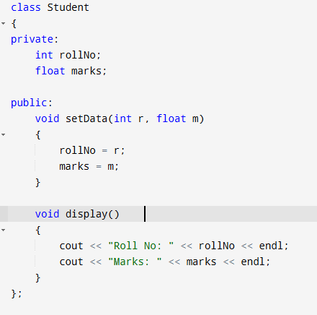
Class
Data Members:
Data Members are variables inside the class
Usually data members are private for data protection.
Member Function:
Member functions are functions inside the class.
They define action of an object.
Usually public

Slide 16


THANK YOU!

